Slide 1
Manchester City Centre is Open

Slide 2
Manchester’s corporate community is acting together to make sure the city centre is open for business.
Together with a wide range of business partners, CityCo, Chamber of Commerce and ProManchester are working with agencies including Manchester City Council, Greater Manchester Police and Marketing Manchester to encourage the sharing of best practice and innovative solutions to working in our new world.
Transport and parking operators, public realm managers, retailers, eateries, and leisure venues, are working hard to instil confidence around public safety. As autumn sets in and we see a return to schools, universities and workplaces, the new ‘normal’ certainly looks different, but Manchester’s public and private sector partners are leading on the response to ensure the city is a safe and welcoming place to return to.
We believe the time is right to encourage city centre employees to safely head back into town to help change-up routines, work flexibly, meet up, share ideas, and enjoy all the city has to offer. This will be vital in the coming months to support all reopened businesses and to help revive the centre economy we all know.
Let’s encourage people to come back into the city centre strongly and together.

Slide 3
Manchester Arndale’s 200+ stores have been welcoming shoppers back with social distancing, compulsory mask-wearing and enhanced cleaning regimes all in place. We still have a long way to go to get back to usual business. Most Arndale shoppers are city centre workers who pop in at lunchtime or after work for essentials and fashion. We look forward to people returning to the city centre. Let’s support the vital economic recovery together.
David Allinson Manchester Arndale

Slide 4
The City Centre is Open
Manchester Arndale, New Cathedral Street, Market Street, King Street, Deansgate and other city centre retailers are open for lunchtime and after-work shopping
Manchester city centre’s hundreds of food and drink outlets are open for daily eats and drinks
Gyms are open for mid-week workouts
Manchester’s cultural venues are open for gallery, cinema, library, and museum visits
Corporate event venues are open for off-site meetings and presentations
The BID’s information officers, Manchester’s City Hosts, are working to help returning workers and visitors

Slide 5
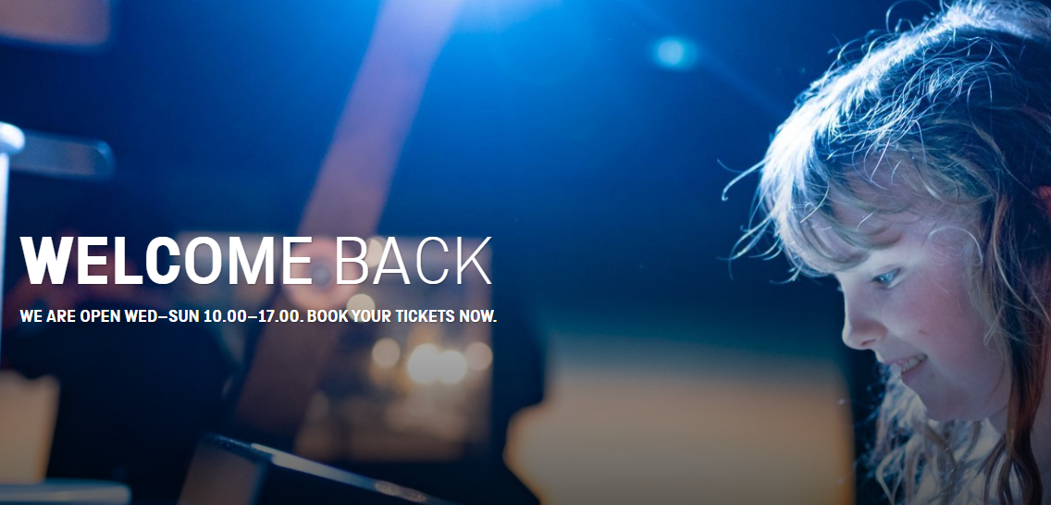
NOW OPEN
HOME
Manchester Art Gallery Manchester Central Library National Football Museum
Everyman, Odeon, Vue Cinemas People’s History Museum Science and Industry Museum
The Printworks
OPENING SOON
Castlefield Gallery (16 September) Manchester Museum (16 September) The Whitworth (16 September)

Slide 6
The City Centre is Prepared
Face coverings are being worn as compulsory on public transport and in all shops
Retailers and city businesses are actively managing entrances, exits, and the number of people in stores/restaurants/cafes with social distancing and well-being measures in place
Employers are continuing to work with staff to make workplace safety the priority
Office landlords are reengineering workspaces with one-way systems, screens, hand-washing stations and full risk assessments in place
Increased street cleansing regimes are running across high footfall streets, including jet-washing
All public transport operators are running enhanced cleaning schedules and displaying additional signage

Slide 7
Getting people back into city centre offices is a vital element of the economy’s recovery that will benefit those in retail, leisure, hospitality and the wider business community. But it has to be done safely, gradually and by providing as much support as possible to our customers and their employees, as well as our own colleagues.
We recognised that from the outset. Safety and wellbeing has underpinned each decision we’ve made so far.
Ciara Keeling, CEO of Bruntwood Works

Slide 8
The City Centre is Accessible
TfGM are committed to getting people moving safely again with public health the priority
Metrolink has been risk assessed and measures are in place to increase social distancing and cleaning
Hand sanitizer dispensers are located at transport interchanges, bus stations and tram stops
TfGM staff are on-hand to assist passengers on platforms and stations
Patrols have increased on trams to remind the public that face coverings are compulsory
Walking and cycling are being encouraged which can improve staff health and wellbeing
Free 1-2-1 training is offered for anyone living within Greater Manchester to improve cycling confidence
Metrolink services are extended by 1 hour: now finishing at midnight Monday-Saturday and 11pm on Sundays
On Sundays, the frequency of tram services are now one every 15 minutes between 7am and 11pm
On Monday-Friday tram services are operating at a 10-minute frequency between 6am and 7pm and then every 20 minutes until midnight
On Saturdays, a 10-minutes frequency is in place between 8am and 8pm and then every 20 minutes until midnight
TfGM are operating as many double trams as possible

Slide 9
At City Tower and No.1 Spinningfields we have been working hard to ensure the building is safe and ready to welcome back occupiers. We’ ve implemented one-way systems, added additional signage to highlight social distancing, installed sanitizer stations and ensured additional routine cleaning. It’s been great to see so many people return to both of our buildings and we are continuing to support occupiers who are in the process of facilitating a safe return to work.
Rob Cosslett Schroder UK Real Estate Fund

Slide 10
Manchester city centre now needs the support of office space landlords, owners, managers and occupiers and encourage a return to work, even if in our new world, flexibility is the new norm.
Let’s work together to help support city centre businesses who depend on the custom of your staff.

